Slide 1
Predicting Liver Disease Using a Feed Forward Neural Network
Aryan Ritwajeet Jha
Currently pursuing PhD ECE (Power Systems)
Notes:
Remember to hit the reset button to make sure all the page elements react properly.
There are 20 different layouts that you can choose from.

Slide 2
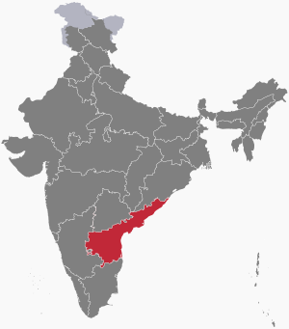
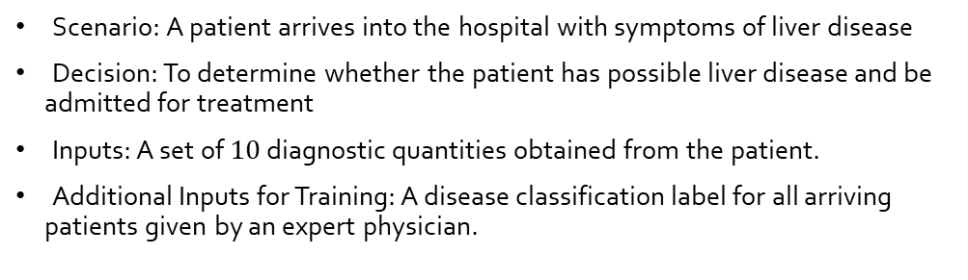
Problem Statement at a Glance [1, 2]
Scenario: A patient arrives into the hospital with symptoms of liver disease
Decision: To determine whether the patient has possible liver disease and be admitted for treatment
Inputs: A set of $10$ diagnostic quantities obtained from the patient.
Additional Inputs for Training: A disease classification label for all arriving patients given by an expert physician.
Diagnostic Quantity | Type
Age | Integer
Gender | Nominal (Binary)
TB | Continuous
DB | Continuous
Alkphos | Integer
Sgpt | Integer
Sgot | Integer
TP | Continuous
ALB | Continuous
A/G Ratio | Continuous

Slide 3
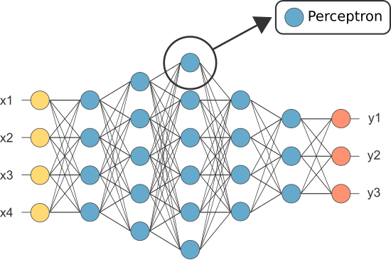
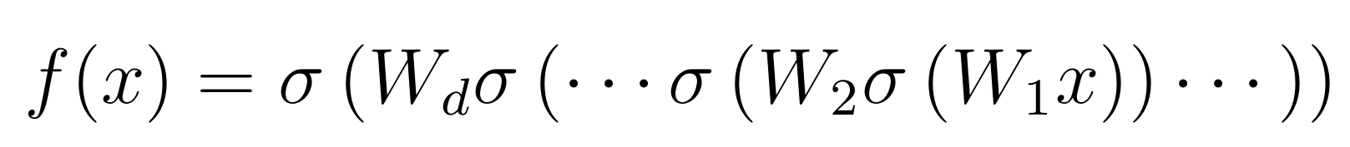
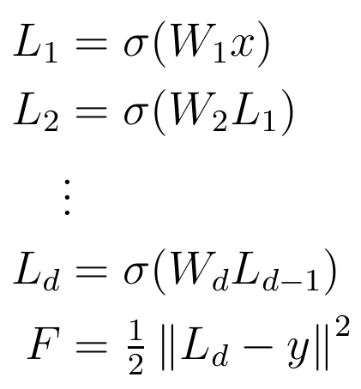
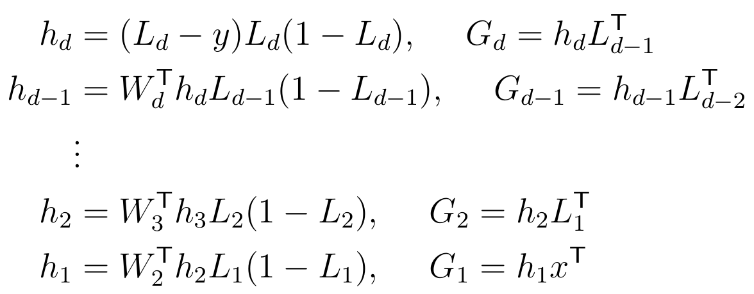

Approach to Solve the Problem
Train a Feed Forward Neural Network
For $10$ features and $1$ classification, we can use a neural network represented by a vector $[10, 10, 10, 1]$.
For activation function, we use the sigmoid function.
Prediction Function
Backpropagation

Slide 4

Preprocessing
Given a chosen architecture for the FFNN, we would like to preprocess the dataset for our solver to have an easier time training the Neural Network.
Drop Missing Data
Convert Nominal String values for Gender to Binary values. $→\{0, 1\}$
Normalize all row values for a given column against the maximum value in that column $→[0, 1]$
Choose training and testing data (Random $70−30$ split)
Choose initial weights $w0$
Map class values to $\{\frac{1}{3},\frac{2}{3}\}$

Slide 5
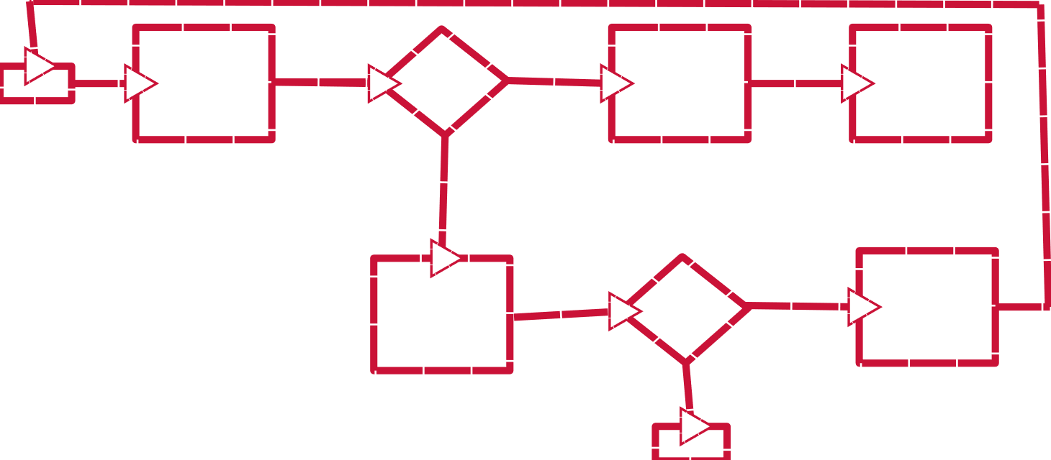
Code base for Training and Using the FFNN
classify == false
Start
nnloss
generate pr
optimize
classify == true
Testing Quality == “Poor”
Testing Quality == “Good”
Retune FFNN
Predict Class Values
Stop

Slide 6
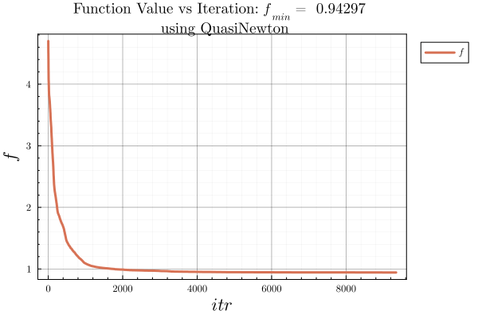
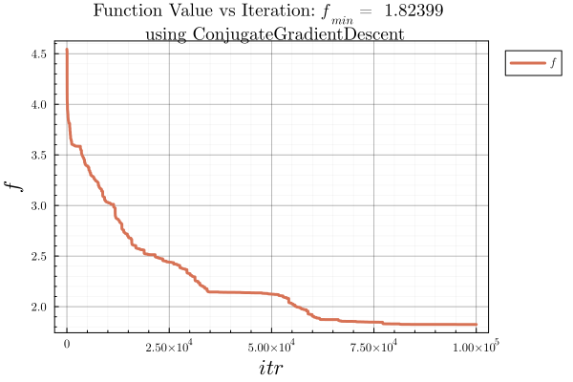
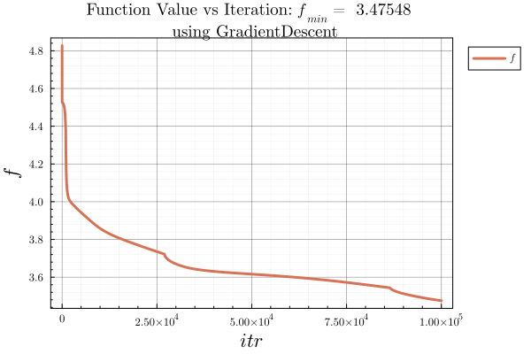
Some results
Results varying, some better than others. Possible causes are:
Random splitting of training and testing datasets
Random initialization of weights
For the ‘base’ FFNN of dimensions [10, 10, 10, 1]:

Slide 7
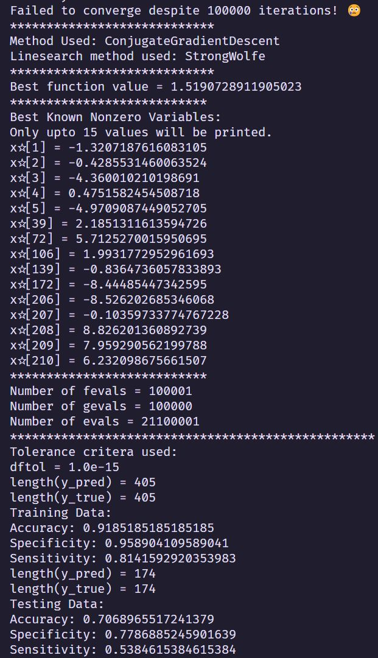
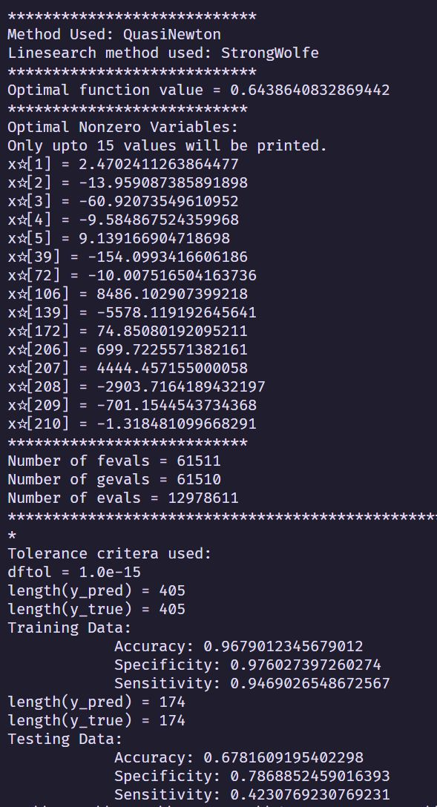
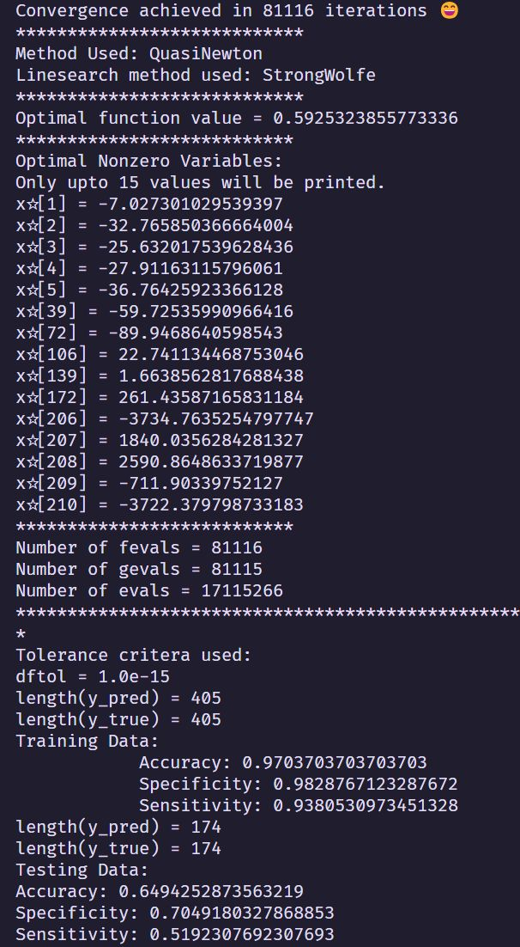
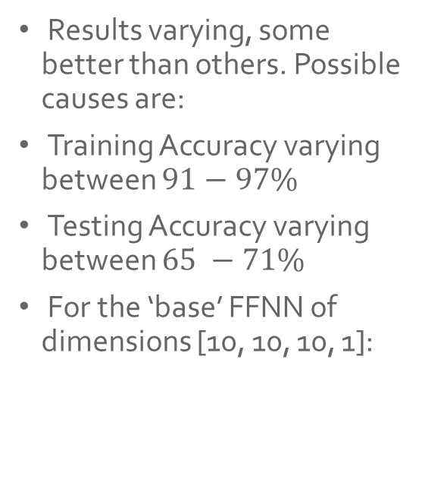
Some results
Results varying, some better than others. Possible causes are:
Training Accuracy varying between $91−97\%$
Testing Accuracy varying between $65 −71\%$
For the ‘base’ FFNN of dimensions [10, 10, 10, 1]:

Slide 8
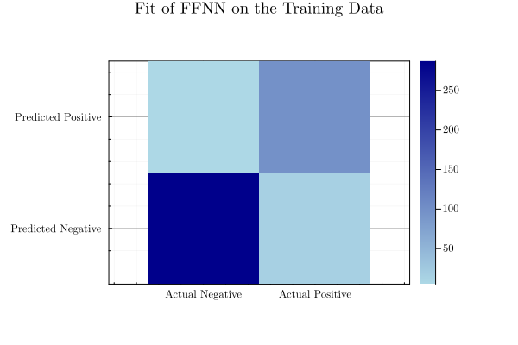
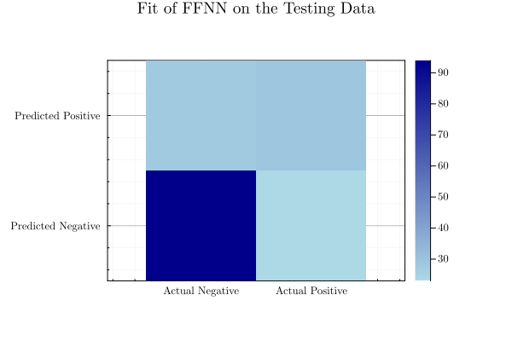
Some results
Typical Confusion Matrix for the ‘base’ FFNN of dimensions [10, 10, 10, 1]:

Slide 9

Other NN architecture experimentation (all runs using QN-BFGS)
Using a single hidden layer: [10, 10, 1] : Poorer fit, even on the Training Data ($80−85\%)$
Using less number of hidden nodes: $[10, 5, 5, 1]$: Less overfitting, gets lower Training Data accuracy $(85\%)$ but similar testing accuracy as ‘base’ architecture $(65−70\%)$.

Slide 10

Other untested ideas
Try dropping some features. This paper [3] talks about how Albumin and A\G Ratio features are not that important when performing a diagnosis.
Try another activation function, such as $tanh⁡()$ or $ReLU$.

Slide 11
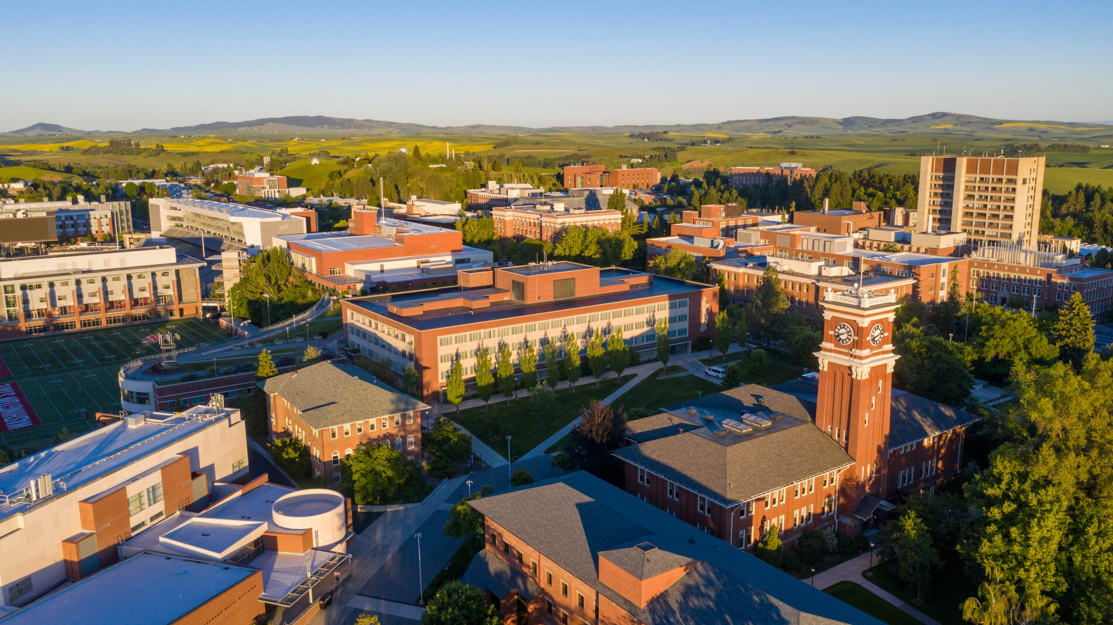
Thank You.

Slide 12
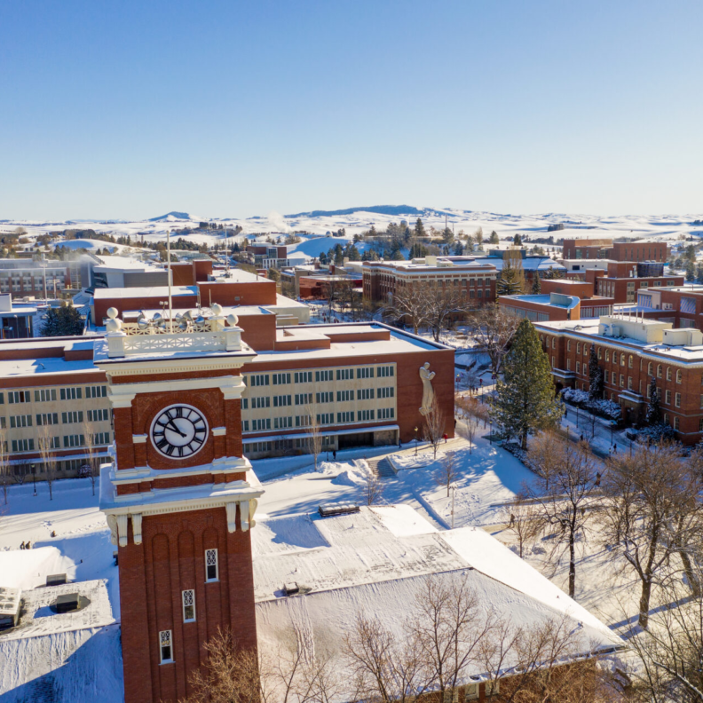
Appendix and References follow

Slide 13
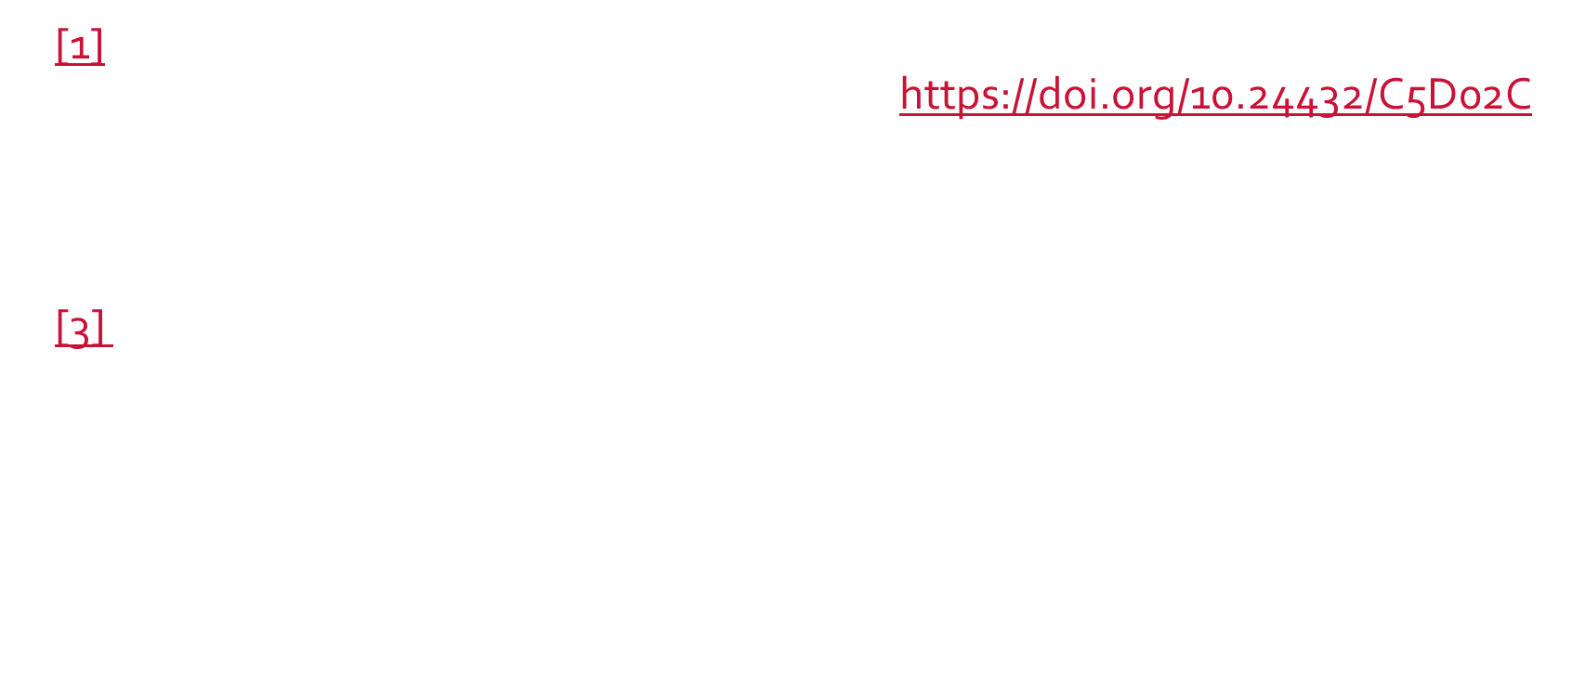
References
[1] Ramana,Bendi and Venkateswarlu,N.. (2012). ILPD (Indian Liver Patient Dataset). UCI Machine Learning Repository. https://doi.org/10.24432/C5D02C.
[2] Class notes and Problem Statements provided by Prof. Tom Asaki as part of the course MATH $564$ Convex and Nonlinear Optimization at Washington State University, for the semester of Fall $2023$.
[3] Straw I, Wu | H Investigating for bias in healthcare algorithms: a sex-stratified analysis of supervised machine learning models in liver disease prediction | BMJ Health & Care Informatics 2022;29:e100457. doi: 10.1136/bmjhci-2021-100457

